Slide 1
Web Engineering
Web Development Methodology

Slide 2
Popular Methodologies
Waterfall
Agile
Scrum
Kanban
DevOps
Rapid Application Development (RAD)

Slide 3
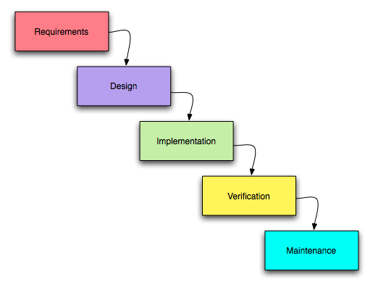
Waterfall

Slide 4
Waterfall
Linear and sequential approach
Stages: Requirements → Design → Development → Testing → Deployment
✅ Best for simple, well-defined projects
❌ Rigid, not suitable for changes mid-project

Slide 5
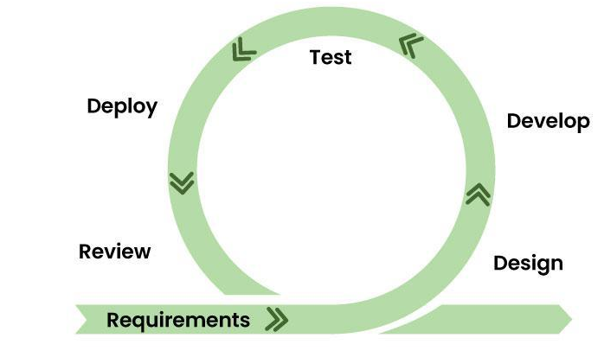
Agile Methodology

Slide 6
Agile Methodology
Iterative and incremental
Frequent delivery of working software
It emphasizes collaboration, frequent feedback, and responding to change to deliver value quickly and efficiently.

Slide 7
Agile Methodology
Instead of rigid, upfront planning, agile breaks down projects into smaller, manageable phases or iterations with continuous testing and improvement
✅ Adaptable to change
❌ Requires strong communication & experienced teams

Slide 8
Scrum
Subset of Agile
Work divided into sprints (1-4 weeks)
Roles: Product Owner, Scrum Master, Development Team

Slide 9
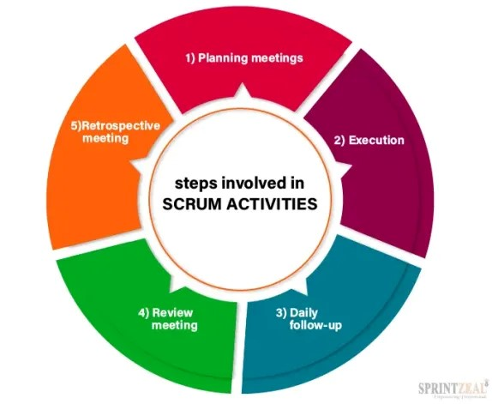
Scrum

Slide 10
Scrum
Product Owner: Responsible for the product vision, managing the product backlog, and maximizing the value delivered by the team.
Scrum Master: Facilitates the Scrum process, removes impediments, and helps the team adhere to Scrum principles.
Development Team: The cross-functional group responsible for delivering the product increment.

Slide 11
Scrum
Daily stand-up meetings for updates
Sprint Planning: The team plans the work for the upcoming sprint.
Daily Scrum: A short daily meeting where team members synchronize and identify any impediments.
Sprint Review: The team demonstrates the work completed during the sprint to stakeholders.
Sprint Retrospective: The team reflects on the sprint and identifies areas for improvement.

Slide 12
Scrum
Product Backlog: A prioritized list of features and requirements for the product.
Sprint Backlog: The subset of the product backlog selected for completion during a sprint.
Increment: The working software delivered at the end of each sprint.
✅ Efficient for fast-paced projects
❌ Needs discipline and self-organizing teams

Slide 13
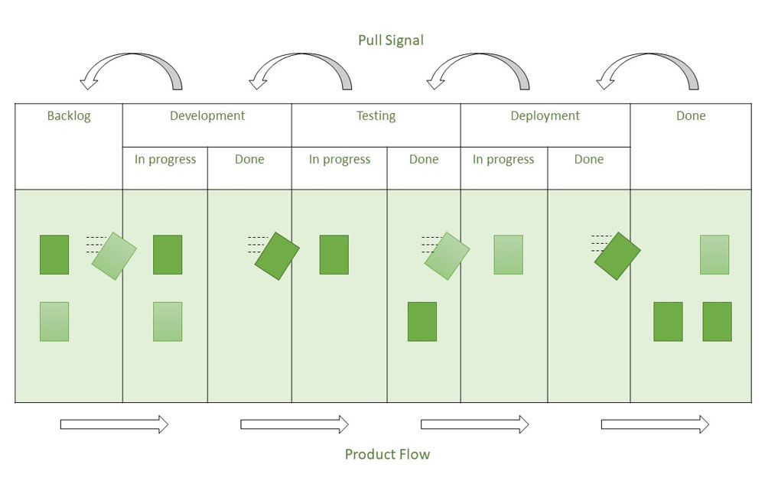
Kanban

Slide 14
Kanban
Visual task management system
Uses a Kanban board (To Do → In Progress → Done)
Focus on continuous delivery and limiting WIP (Work in Progress)
✅ Great for support & maintenance teams
❌ Can be inefficient without clear prioritization

Slide 15
DevOps
Combines development and operations
DevOps promotes the use of Continuous Integration and Continuous Delivery(CI/CD)
Promotes collaboration, faster releases, and monitoring
✅ Ideal for modern, scalable apps
❌ Requires cultural shift and infrastructure

Slide 16
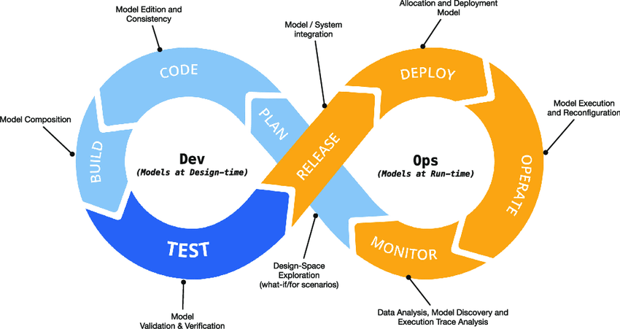
DevOps

Slide 17
DevOps
Benefits of DevOps:
Faster Time to Market:
Improved Software Quality:
Increased Efficiency:
Reduced Costs:
Enhanced Customer Satisfaction

Slide 18
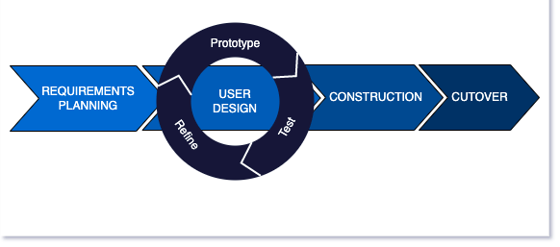
Rapid Application Development (RAD)

Slide 19
Rapid Application Development (RAD)
Emphasizes rapid prototyping and user feedback
Involves iterative development with reusable components
✅ Good for time-constrained projects
❌ May sacrifice scalability and structure

Slide 20
Rapid Application Development (RAD)
How RAD Works:
1. Requirements Planning:
Instead of a lengthy, detailed plan, RAD focuses on quickly gathering core requirements and understanding the user's needs.
2. Prototyping:
Developers quickly build a basic prototype that demonstrates the core functionality of the system.
3. User Feedback:
The prototype is presented to users for feedback, which is then used to refine the prototype.

Slide 21
Rapid Application Development (RAD)
How RAD Works:
4. Iteration and Refinement:
The cycle of prototyping, feedback, and refinement is repeated until the final product meets user expectations.
5. Testing and Integration:
Once the prototype is refined, it's tested and integrated with other components to create the final application.
6. Deployment:
The completed application is deployed to the users.

Slide 22
THANKS

